Slide 1

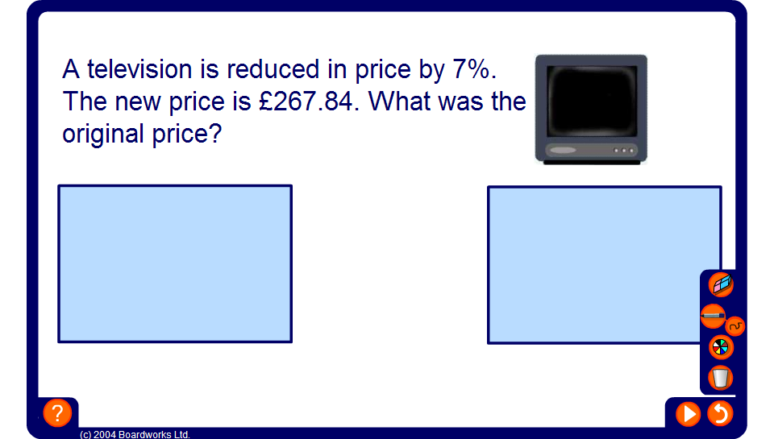


Finding the original amount
Notes:
Talk through as many examples as necessary.

